Slide 1


Snake Game
Integral University
A Project
on
Presented By:
Md Ahtisham

Slide 2
Content
Introduction
Requirements(Software/Hardware)
Working Rules
Objective
Future of the program

Slide 3

Introduction
The Project is a snake game written in python
I used python pygame library
Pygame includes graphic and sound libraries
Snake game is one of the most popular arcade game
It was programmed by Taneli Armanto
The concept is originated in 1976

Slide 4

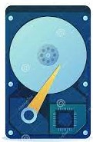
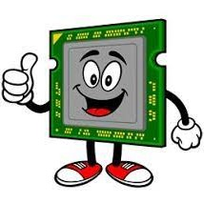
Requirement
Software Requirement
Operating System : Windows
Language : Python
Library : PyGame
Hardware Requirement
Hard Disk : 80 GB
Ram : 2GB
Processor : Intel P4 1.5Ghz or Above

Slide 5
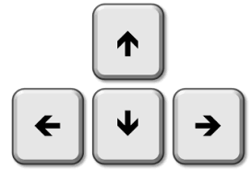


Working Rules
Arrow Keys
Eat Food
Increase length
Get Score
Game continues until snake dies
Game over

Slide 6
Objective
How to Written Snake Game in python
Basic understanding in pygame
Improve knowledge in GUI
Control game with keys
Manage Score

Slide 7
Future of the program
Our project implement in future after making some changes and modification
Good Graphic
Add multiplayer option
Sound
Increase fps
Top Score and Player Profile

Slide 8
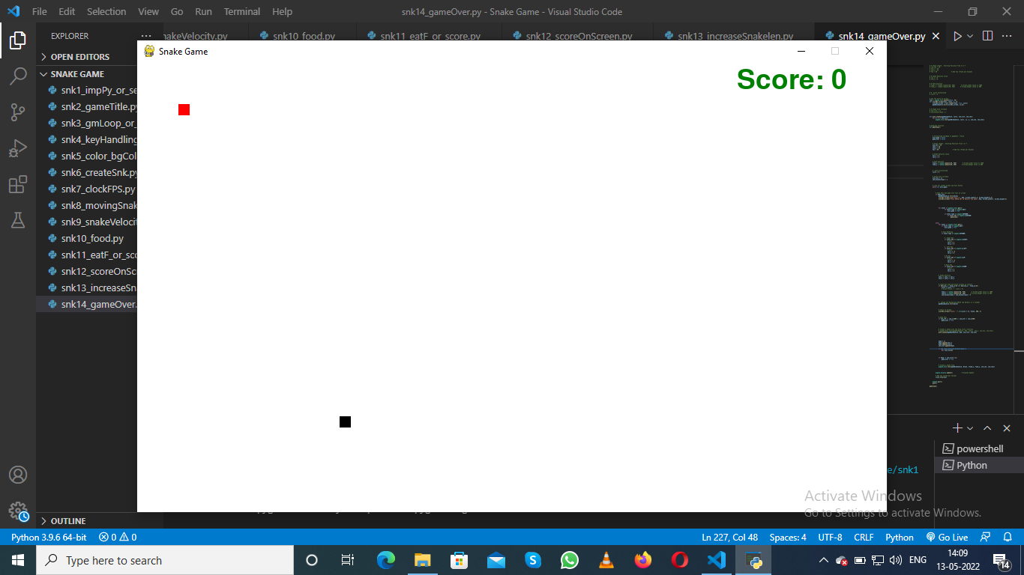
.
.

Slide 9
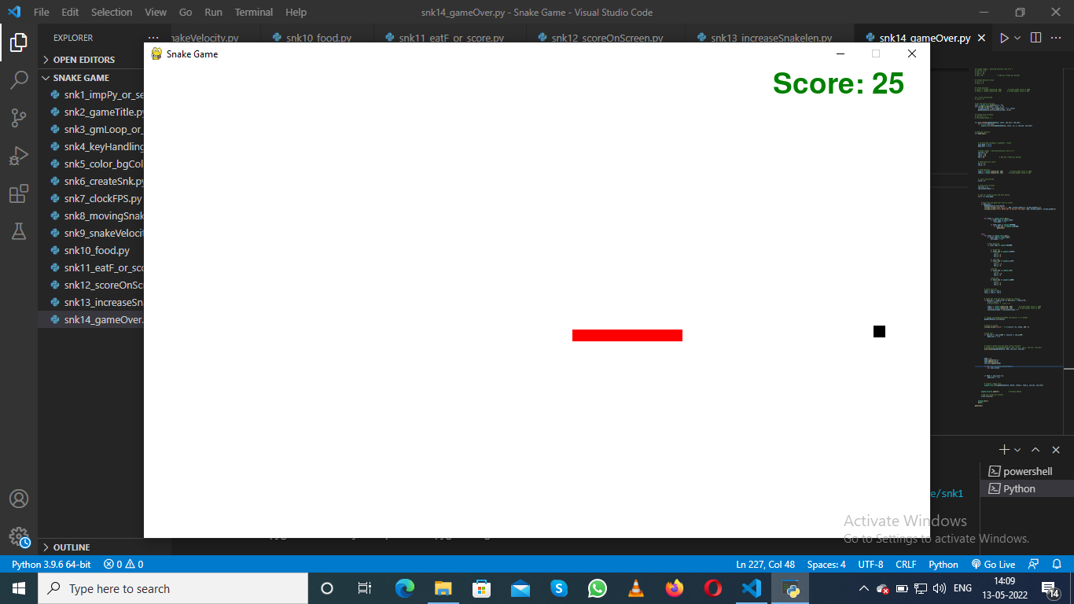

Slide 10
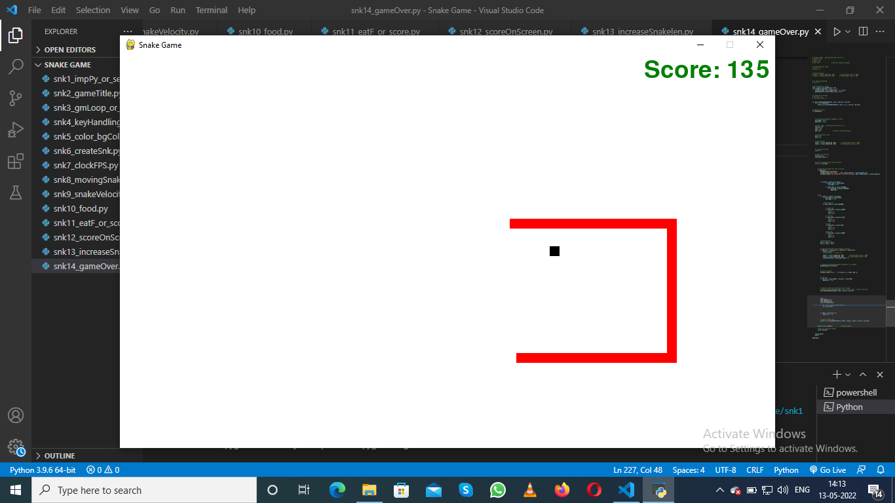
.
.

Slide 11

Thank You

